Slide 1
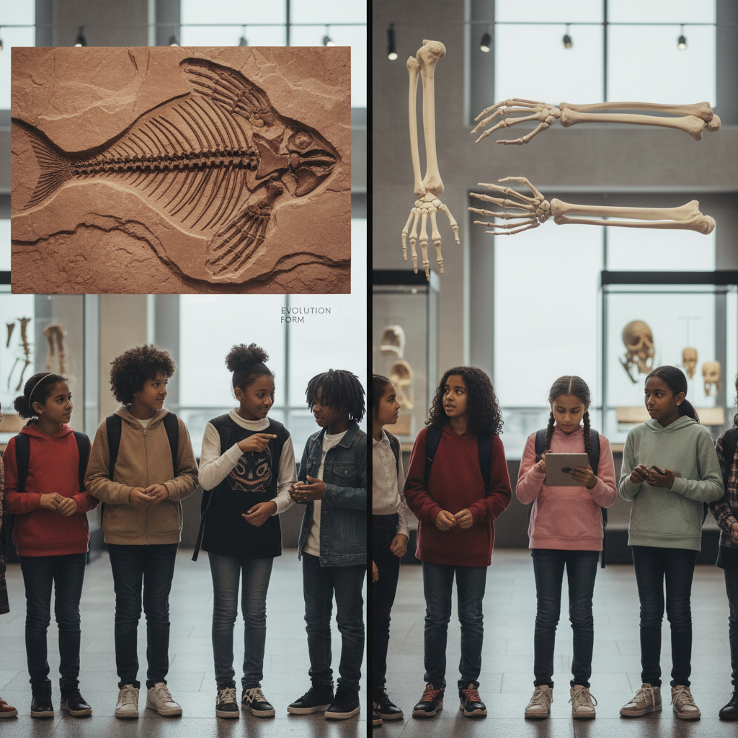
ModelIt!
Student Lesson
Your Inner Fish
Why You Share Bones with a 375-Million-Year-Old Fish
NGSS: MS-LS4-1, MS-LS4-2
7th Grade
1/9

Slide 2
What You Will Learn Today
Learning Goals
* Analyze fossil evidence showing how species have changed over millions of years
* Model how environmental change drives species diversification and extinction
* Identify homologous structures as evidence of common ancestry
* Explain how the fossil record supports the theory of evolution
Key Vocabulary
Fossil Record
The collection of all known fossils arranged chronologically, showing the history of life on Earth
Homologous Structure
Body parts in different species that share the same basic structure because they evolved from a common ancestor
Common Ancestor
An ancient organism from which two or more different species evolved over time
Transitional Fossil
A fossil that shows features of both an ancestral group and a descendant group
2/9

Slide 3
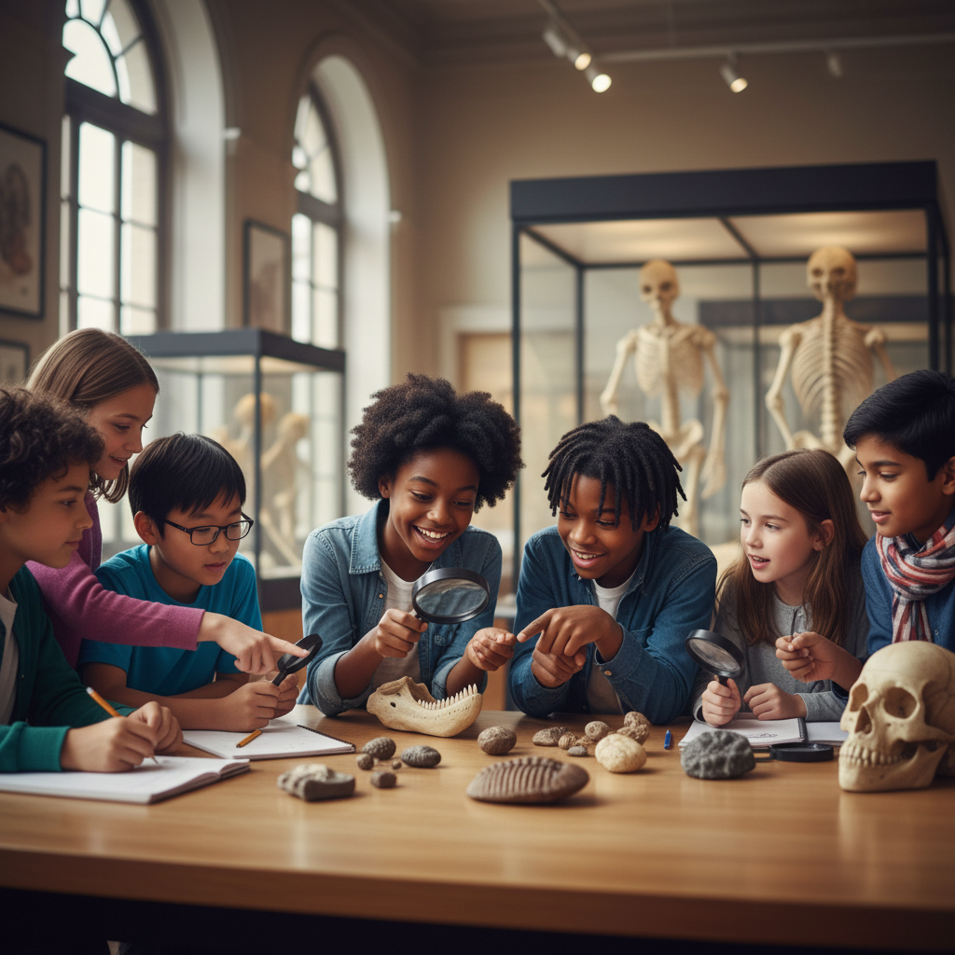
The Big Question
Why do humans have the same bones as a fish that lived 375 million years ago?
Why You Share Bones with a 375-Million-Year-Old Fish. Today we'll build a MODEL to discover the answer!
3/9

Slide 4

Today We Will Build a Model!
A model helps us understand complex systems!
1. LOCATE
Identify the COMPONENTS (parts) of the system
2. ESTABLISH
Connect them with RELATIONSHIPS (+ or -)
3. VISUALIZE
Build your model in ModelIt!
4. EVALUATE
Run SIMULATIONS to test scenarios
5. REVISE
Improve your model based on evidence
4/9

Slide 5
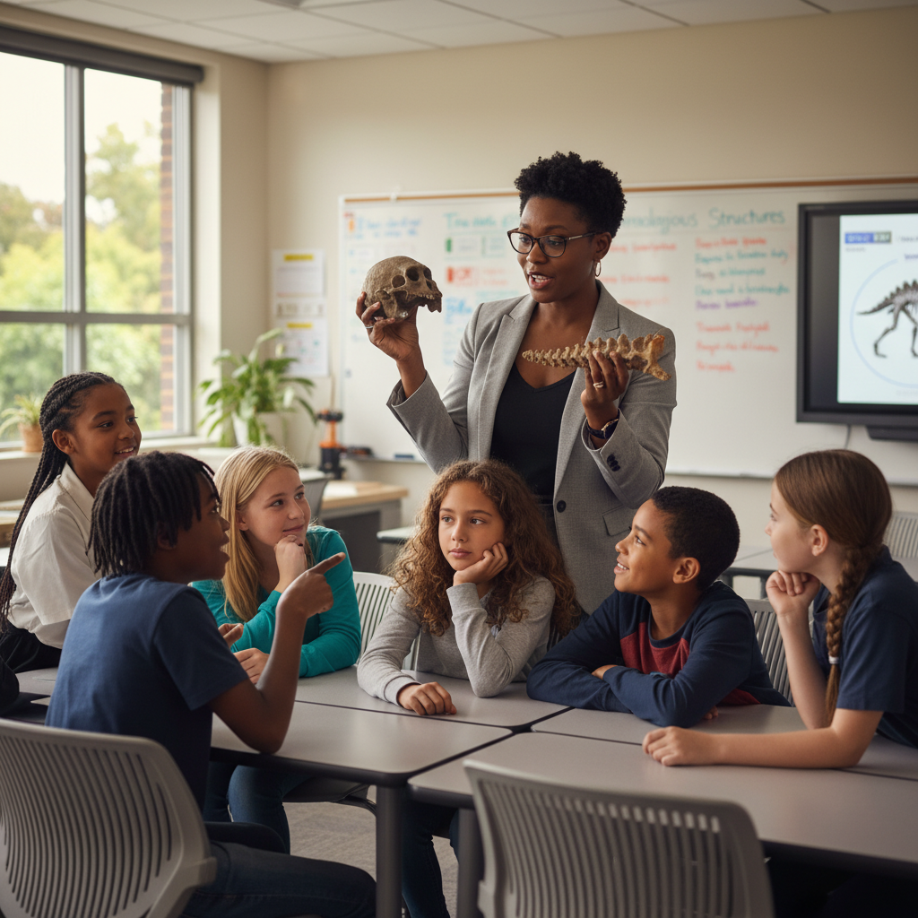
Activity 1: Sort the Components
Sort these components into EXTERNAL (inputs from outside) and INTERNAL (inside the system):
Your Components:
* Environmental Change Rate
* Time (Millions of Years)
* Anatomical Similarity
* Species Diversity
Think: Which components can we control? Which happen on their own?
5/9

Slide 6
Activity 2: Connect with Arrows
Draw arrows to show HOW components affect each other:
(+) POSITIVE Relationship
When one goes UP, the other goes UP too
(-) NEGATIVE Relationship
When one goes UP, the other goes DOWN
Think About It:
When environmental change rate increases dramatically, what happens to species diversity? Does it always go up, or can it crash?
6/9

Slide 7
Activity 3: Run the Simulation!
Test these scenarios in ModelIt!
Stable Environment
Set Environmental Change Rate low and observe Species Diversity over time
Mass Extinction Event
Lock Environmental Change Rate to maximum and observe the cascade
Gradual Adaptation
Set moderate change and track Anatomical Similarity over millions of years
Watch the activity graphs change!
[ModelIt Platform Screenshot - Simulation Results Graph]
7/9

Slide 8
What Did We Discover?
Our Model Showed Us:
* Species that can't adapt to environmental change go extinct — creating gaps in the fossil record
* Homologous structures prove that very different-looking animals evolved from common ancestors
* Mass extinction events reduce diversity temporarily but open ecological niches for new species
* The fossil record shows a clear pattern: simple organisms came first, complexity increased over time
Answer: Humans share bones with ancient fish because we evolved from the same common ancestor. The fossil Tiktaalik (375 million years old) shows the transition from fins to limbs. Our arm bones — humerus, radius, ulna — are the SAME bones, modified over millions of years through evolution!
8/9

Slide 9
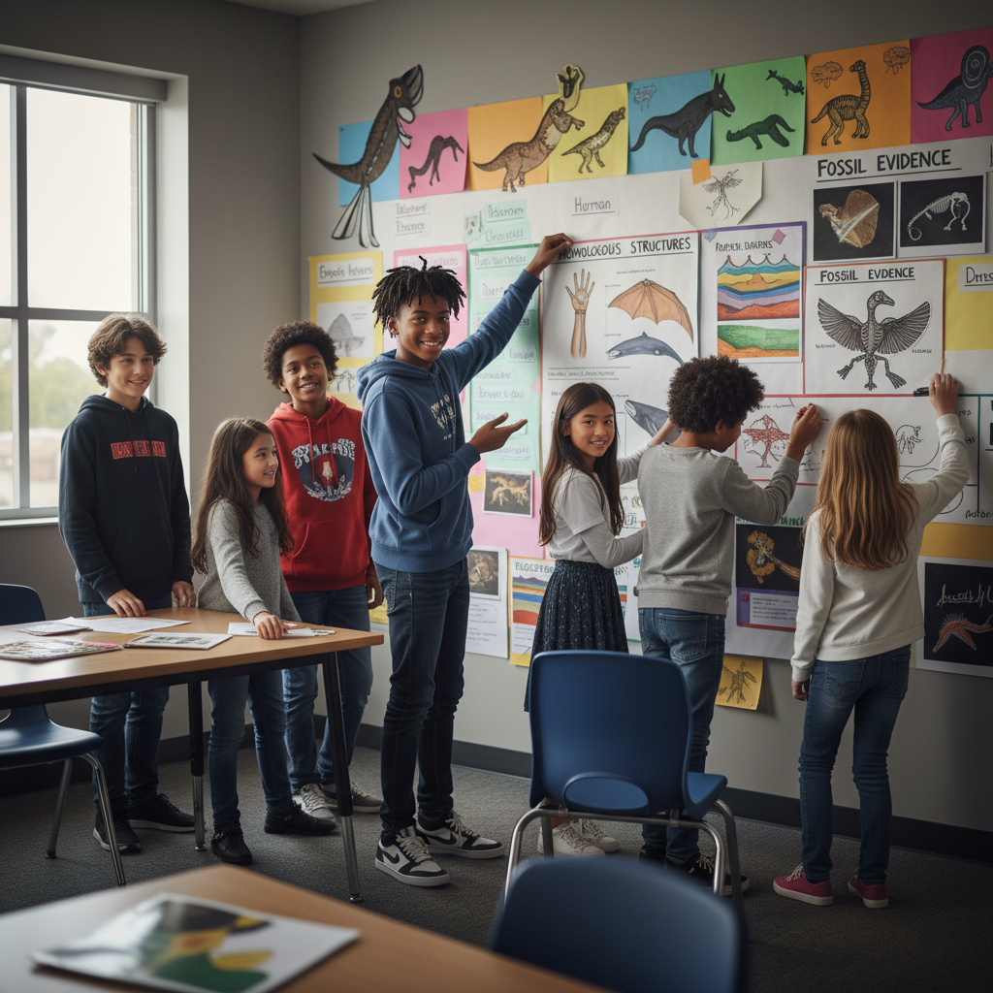
STEM Challenge: Build an Evolutionary Evidence Wall
YOUR ENGINEERING MISSION
Create a visual display showing evidence for evolution from the fossil record, including homologous structures and transitional fossils, for a natural history museum.
The Challenge:
A natural history museum needs a new exhibit showing how scientists use fossils and anatomy to trace evolutionary relationships. Your team will design the exhibit using evidence from your model.
Think Like an Engineer:
* What fossil evidence most clearly shows evolutionary relationships?
* How do you visually show homologous structures across different species?
* What story does your evidence wall tell about the history of life?
REAL CAREER CONNECTION: Paleontologists excavate and study fossils to understand the history of life on Earth. They work for museums, universities, and geological surveys, earning $55,000–$110,000/year. The skills you're using TODAY are the same ones they use on the job!
9/9

